Slide 1

Pulse diagnosis System for Nadi Pariksha using parametric and statistical analysis
B. Tech ECE FINAL YEAR PROJECT –FINAL REVIEW
(To Engineer and Design an electronic Pulse diagnosis
system based on concept of
‘Tridosha’ through advanced bio signal processing)
By AMIT KADARMANDALGI
(15BEC0146)
Under guidance of Dr.Mythili A
-Associate professor at
Sensor and Biomedical Technology division
School of electronics engineering

Slide 2
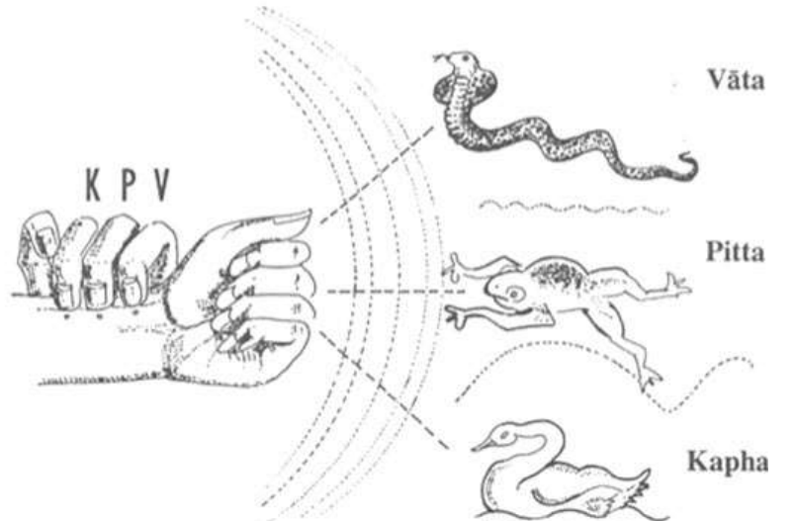
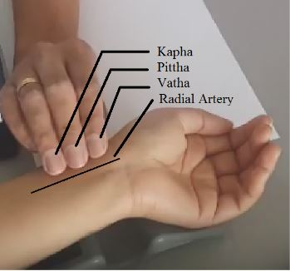
WHAT IS NADI PARIKSHA?
Fig 1. Nadi Pariksha (analyzing tridosha)

Slide 3
INTRODUCTION
Nadi Pariksha (pulse-based diagnosis) is a prominent method in Ayurveda, and is known to dictate all the salient features of a human body.
Prior systems for obtaining the Nadi pulses have been few and far between, when compared to systems such as ECG, microphone and pressure sensors using software like Labview.
The pulse waveform is also shown to have the desirable variations with respect to age of patients with respect to various pulse parameters acquired at the sensing element. Hence a system is needed by Ayurvedic practitioners as a computer-aided diagnostic tool.
Index Terms—Ayurveda, pulse waveform, varying pulse.

Slide 4
MOTIVATION
The main motive behind this project is to uplift traditional practices used in ancient Vedic system which has been proven globally yet we have become accustomed to western practices.
The skill of “Nadi Pariksha” has been researched and published by various authors and yet we hesitate to adopt these methods.
To Engineer and Design an electronic Pulse diagnosis system based on concept of ‘Tridosha’ as the number of skilled physicians in this practice are diminishing.

Slide 5
OBJECTIVE
The product designed should help a doctor visually distinguish the dominant pulse to understand patients condition.
The research part includes acquiring noise free signal and applying parameters related to PPG sensor such as pulse wave velocity(PWV), augmentation index(AI) & reflectivity index(RI).
After collecting the data sets for healthy people this standard signal can be used as a reference to check if there is deviation in Vatha, Pittha, Kapha dosha in patients with anxiety, rashes, common cold respectively.
The research should help us in getting better results by comparing them to methods used in reference papers in similar line of work.

Slide 6
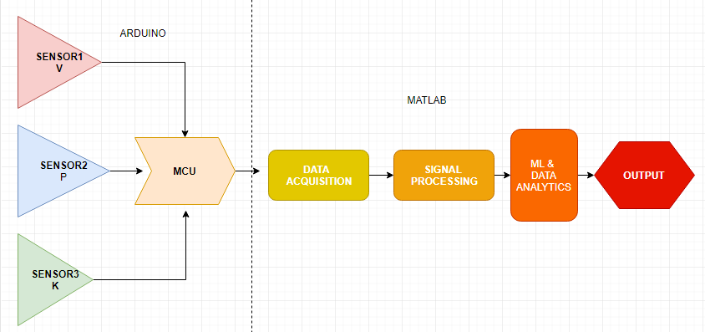
SYSTEM DESIGN AND METHODOLOGY

Slide 7
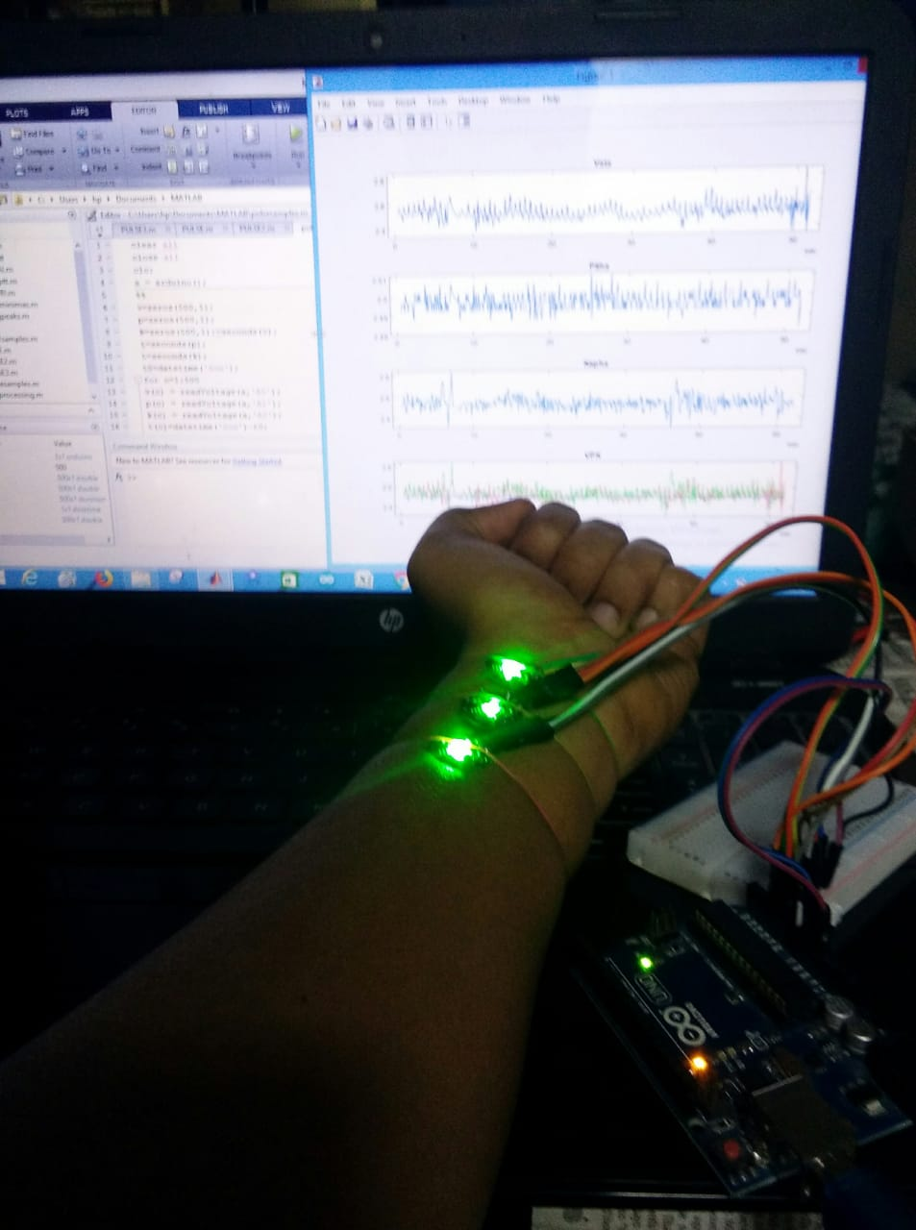
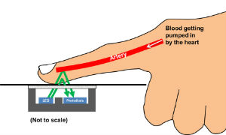
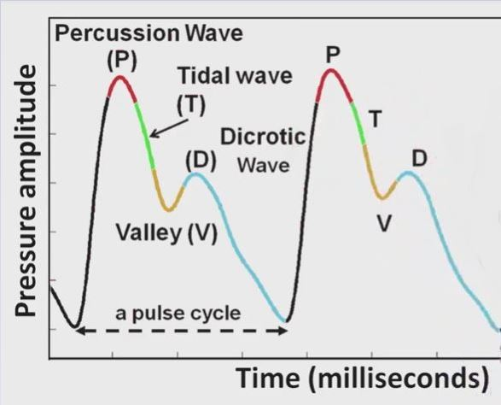
Fig. 2. (a)Hardware Setup using Arduino and Matlab
(b) Working principle of PPG sensor
(c) PTVD pattern
Notes:
poo

Slide 8
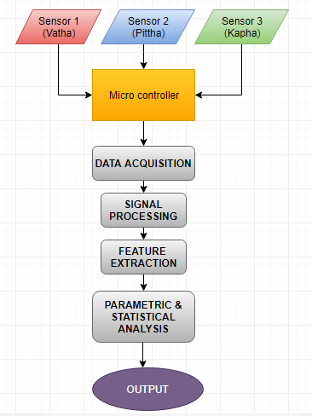
Data acquisition : where three pulses “Vatha” , “Pittha” , “Kapha” for different people using PPG sensors and arduino.
Signal processing : to improve the output plots.
Feature extraction : involves detection of Rising and Falling Peaks.
Parametric analysis : using the feature extracted mainly pulse wave velocity, reflectivity and augmentation index.
Statistical analysis : to derive the standard V P K signal obtained from finding average of data sets obtained from healthy people and then testing it by comparing those with unhealthy people.
The output is to indicate imbalance in any form of dosha

Slide 9
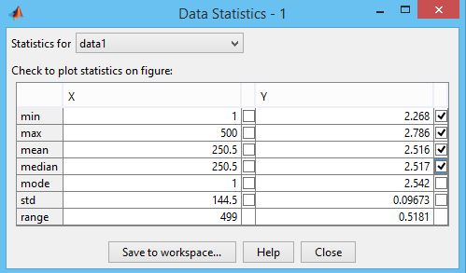
1)DATA ACQUISTION
The three pulses signals “Vatha” , “Pittha” , “Kapha” were obtained by positioning PPG sensors on the wrist of patient.
Data obtained from arduino micro controller was transferred to matlab in the form of analog voltage readings with respect to time.
These datasets were stored in excel sheets.
v | p | k | t
2.492669 | 2.487781 | 2.443793 | '0.586 sec'
2.502444 | 2.492669 | 2.688172 | '0.842 sec'
2.502444 | 2.487781 | 2.497556 | '0.999 sec'
2.502444 | 2.492669 | 2.521994 | '1.132 sec'
2.502444 | 2.487781 | 2.473118 | '1.294 sec'
Fig. 3. Data acquisition

Slide 10
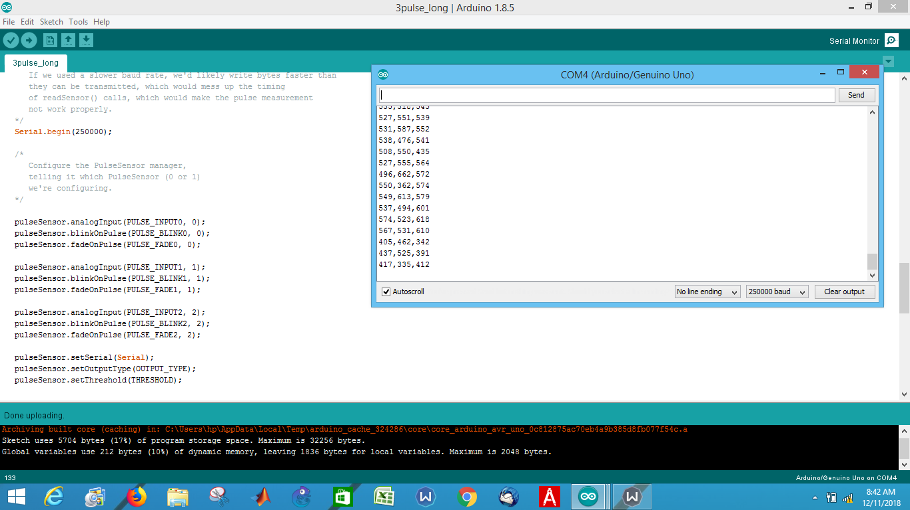
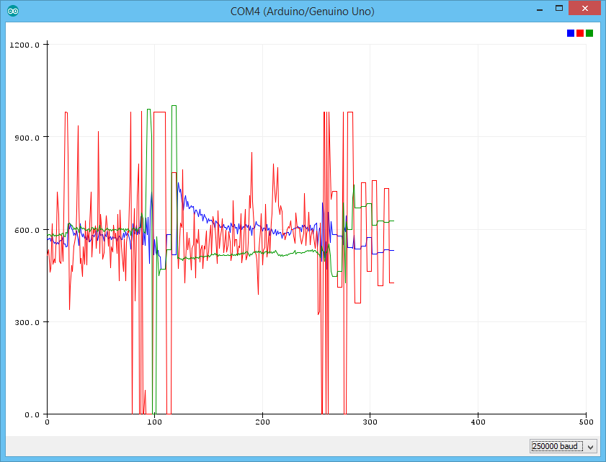
Fig.3. Arduino interfaced with PPG sensor
Fig.4. Arduino Serial plotter – VPK BPM plot
Fig 6.1.2. Arduino Serial plotter – VPK BPM plot

Slide 11
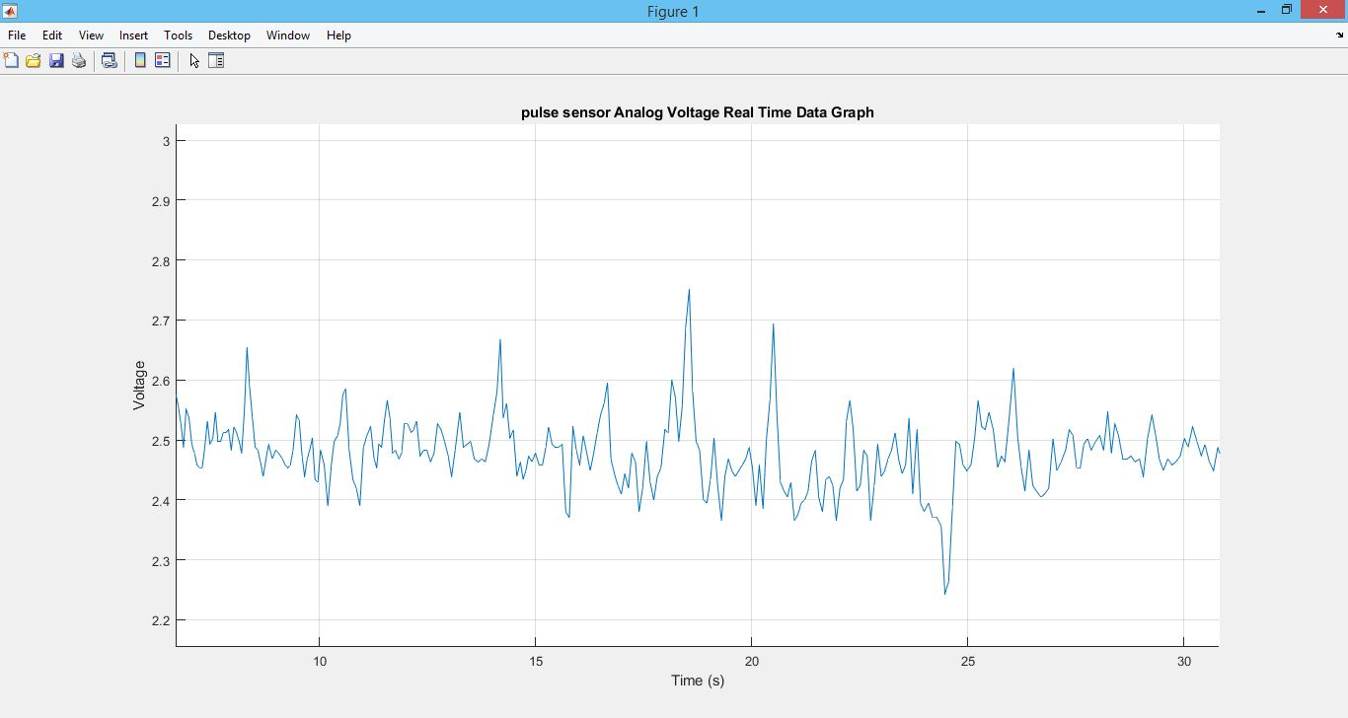
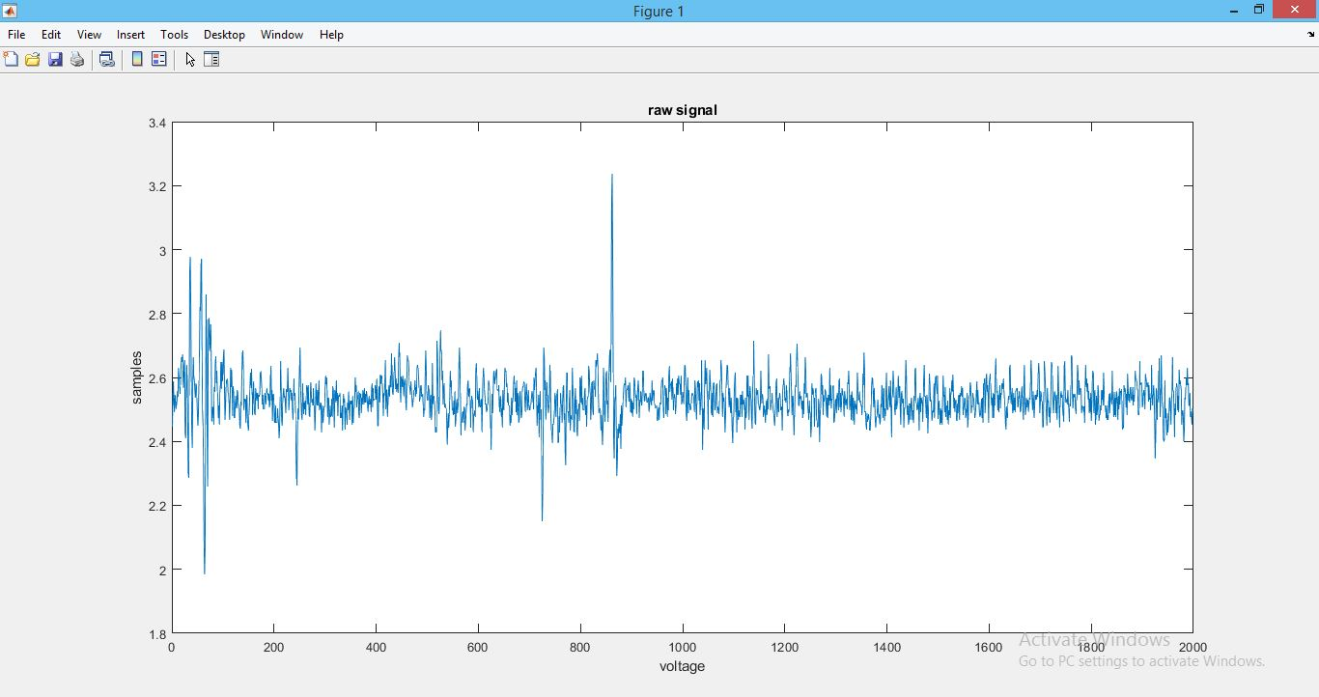
Fig 5. Voltage readings with respect to time
Fig 6. Voltage readings with respect to sampling rate

Slide 12
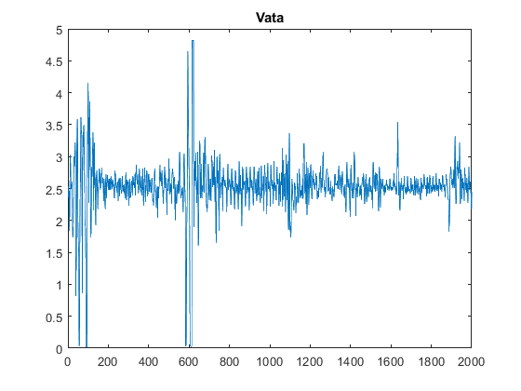
Fig. 7. Raw Signal of Pulse sensors for Data acquisition
X axis- Number of Samples taken(2000)
Y axis- Voltage readings of each sample

Slide 13
2) SIGNAL PROCESSING
The signal obtained from a PPG sensor has noise of different forms
Pre processing has to be done through periodogram and power spectral density.
Based on this various methods were adopted to remove different noise forms

Slide 14
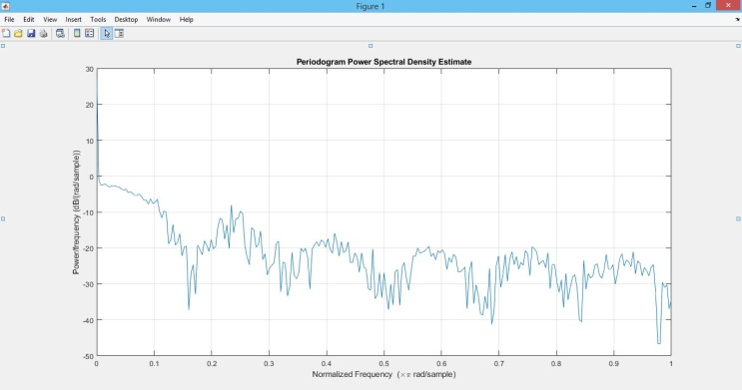
Fig. 8. Periodogram power spectral density of signal
X-axis : Normalized Frequency Y-axis: Power / Frequency

Slide 15
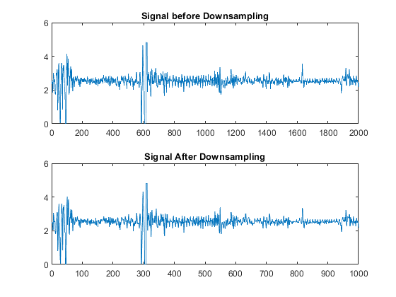
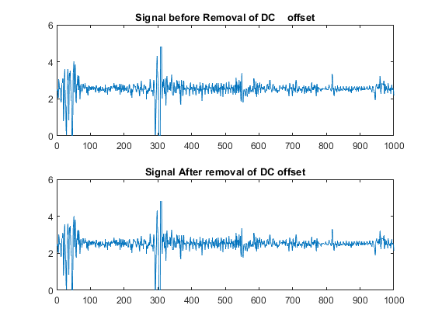
Fig. 9. (a) Signal before and after downsampling
(b) Signal before and after removing DC offset.

Slide 16
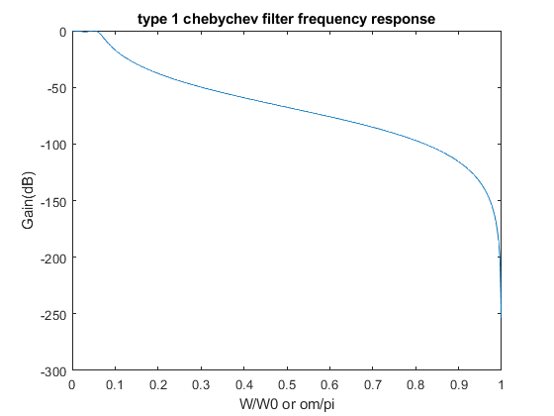
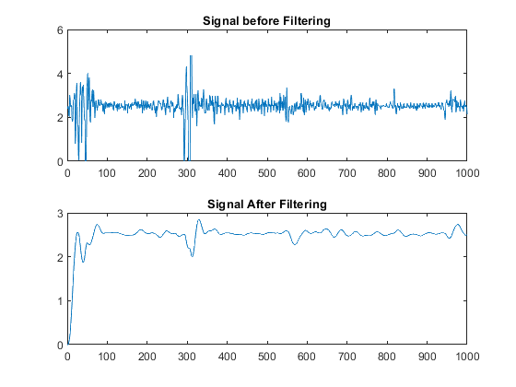
Fig. 10. (a) Output of Low pass Filter
X axis- Normalized Frequency Y axis- Amplitude in dB
(b) Signal before and after filtering

Slide 17
3) FEATURE EXTRACTION
In this case finding the rising and falling peaks are the features of the signal which are further used in parametric analysis.
Calculate the value of threshold.
In case of peaks:
Threshold=mean(signal)+stddev(signal)
In case of troughs,
Threshold=mean(signal)-stddev(signal)

Slide 18
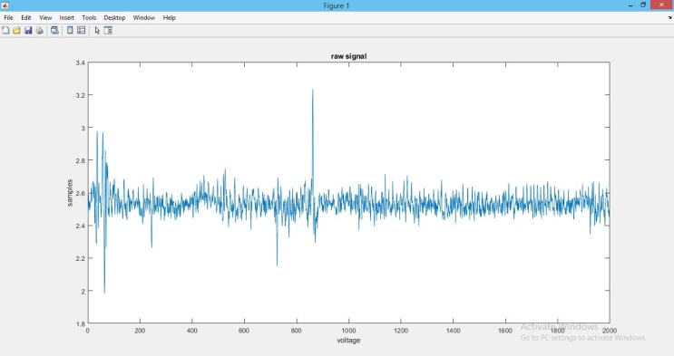
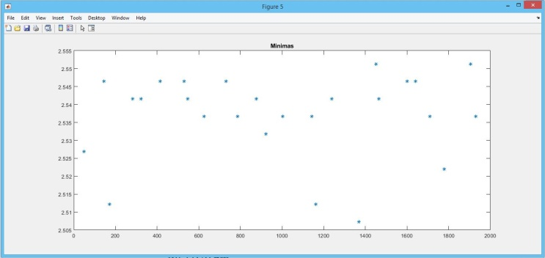
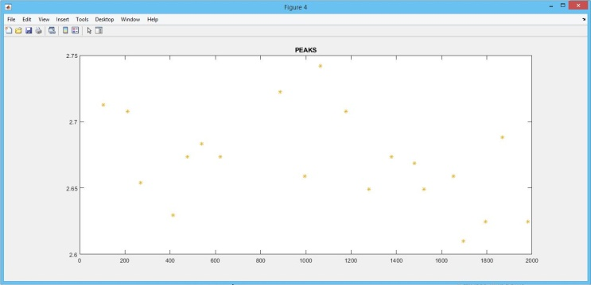
Fig. 11. Plotting minima and peaks of the signal (a) Raw Signal (b) Finding Minimas of Signal (c) Finding Peaks of Signal

Slide 19
4) PARAMETRIC ANALYSIS
Pulse Wave Velocity : rate at which pressure waves move down the vessel with respect to sensors at different positions.
Augmentation index : measure of systemic arterial stiffness derived from the ascending aortic pressure waveform.
Reflectivity index : measure of arterial stiffness based on reflected light from blood vessels during a pulse signal.

Slide 20
5) Statistical analysis
Average values | Vatha | Pittha | Kapha
Mean (V) | 2.4908 | 2.4969 | 2.5354
Standard Deviation | 0.0082 | 0.0241 | 0.0638
Pulse wave velocity | 3.56E+04 | 9.98E+05 | 9.33E+05
Augmentation Index | 0.9775 | 0.6517 | 0.201206
Reflectivity Index | 99.6099 | 99.6094 | 91.0646

Slide 21
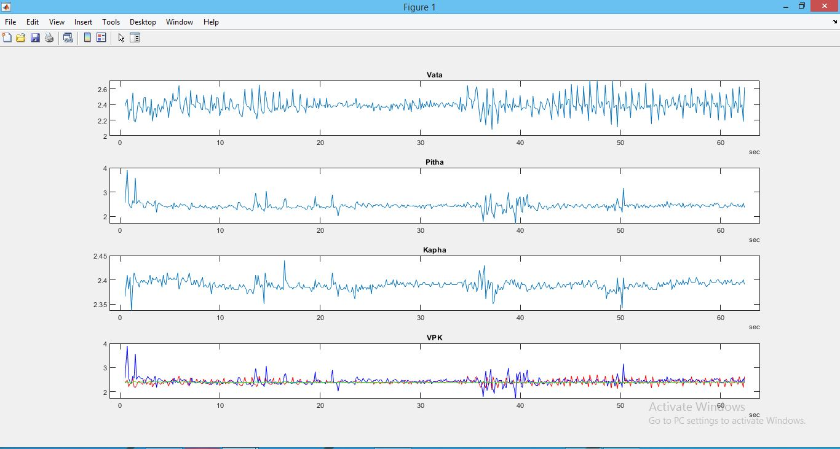
Fig. 12. Average V P K signal of a healthy person for comparative analysis

Slide 22
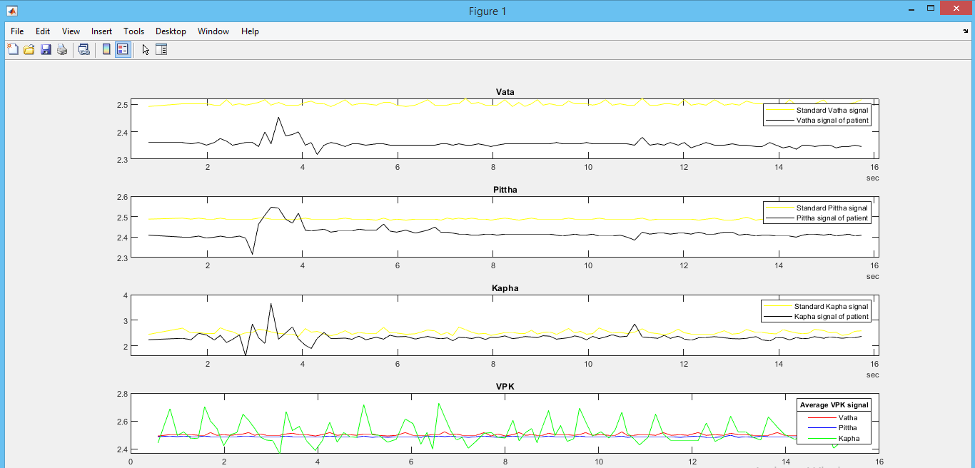
Fig. 13. Comparative analysis with respect to standard V P K signal

Slide 23
RESULTS AND DISCUSSION
Designing a Simple Hardware with focus on methodology involved in data acquisition, algorithm design and analytical techniques.
A standard V P K signal has been plotted considering the average of data sets obtained from healthy patients along with parameters and each of them have a significant role.
There were significant deviations observed from the standard V P K signal when tested with diseased patients as expected from theoretical results.

Slide 24
CONCLUSION
Nadi Pariksha is a great skill used in ancient Ayurveda which is slowly being forgotten and considered non scientific. Hence this research focused on collecting large data sets with the right sensors to scientifically verify this skill. This paper not only attempts to achieve this to a great extent but also gives importance to approach involved designing algorithms and performing analytics. As a product we have achieved a new approach towards computer aided health diagnosis tools. Most of the results obtained satisfied the theoretical results.

Slide 25
SCOPE FOR IMPROVEMENT
Collecting larger data sets: As of now the data set has been collected from about 100 people and for a better research point of view there is a need for more volunteers.
Improving the product design: currently we are using rubber bands and gloves to hold sensors at the right position but for making it as a usable product the design needs to be improved.
Machine learning: the process of collecting data, finding average and comparative analysis was done manually but it will be very challenging to introduce machine learning to improve the device .

Slide 26
TIMELINE
Sno. | Month | Task
1 | December | Literature survey and identification of problem
2 | January | Hardware Implementation of base paper upto data acquisition
3 | February | Applying various bio signal processing techniques and drafting a research paper based on the progress
4 | March | Deriving average signal from data set and doing comparative analysis. Taking part in IPACT-19 conference for TECHNICAL PAPER PRESENTATION
5 | April | Final review , project submission

Slide 27
REFRENCES
• Wireless photo plethysmographic device for heart rate variability signal acquisition and analysis
Published in: 2012 Annual International Conference of the IEEE Engineering in Medicine and Biology Society
https://ieeexplore.ieee.org/document/6346372
• Multimodal cardiovascular information monitor using piezoelectric transducers for wearable healthcare
Published in: 2017 IEEE International Workshop on Signal Processing Systems (SiPS)
https://ieeexplore.ieee.org/document/8110006/
• Diagnosis of Disease Using Wrist Pulse Signal for classification of pre-meal and post-meal samples
Published in: 2015 International Conference on Industrial Instrumentation and Control (ICIC)
https://ieeexplore.ieee.org/document/7150864/
• Nadi Tarangini: A Pulse Based Diagnostic System
Published in: 2007 29th Annual International Conference of the IEEE Engineering in Medicine and Biology Society
https://ieeexplore.ieee.org/abstract/document/4352762/
• Design, development and comparative performance analysis of Bessel and Butterworth filter for Nadi Pariksha Yantra
Published in: 2016 IEEE International Conference on Engineering and Technology (ICETECH)
https://ieeexplore.ieee.org/document/7569413/
Wang, Peng, Wangmeng Zuo, and David Zhang. "A compound pressure signal acquisition system for multichannel wrist pulse signal analysis." IEEE Transactions on Instrumentation and Measurement 63.6 (2014): 1556-1565.
https://ieeexplore.ieee.org/abstract/document/6748032

Slide 28
Analysis of Tridosha in Various Physiological Conditions
Published in: 2015 IEEE International Conference on Electronics, Computing and Communication Technologies (CONECCT)
https://ieeexplore.ieee.org/document/7383890
• Arterial Pulse System: Modern Methods For Traditional Indian Medicine
Published in: 2007 29th Annual International Conference of the IEEE Engineering in Medicine and Biology Society
https://ieeexplore.ieee.org/document/4352363
• A Framework for Automatic Time-Domain Characteristic Parameters Extraction of Human Pulse Signals EURASIP Journal on Advances in Signal Processing20072008:468390 https://asp-eurasipjournals.springeropen.com/track/pdf/10.1155/2008/468390
• Perspectives of Ayurveda in Integrative Cardiovascular Chinese Medicine for Patient Compliance
https://www.elsevier.com/books/perspectives-of-ayurveda-in-integrative-cardiovascular-chinese-medicine-for-patient-compliance/al-shura/978-0-12-817570-5
Che, Xingsheng, et al. "Research on Pulse Power Spectrum calculation method based on TCM." 2015 IEEE International Conference on Communication Software and Networks (ICCSN). IEEE, 2015.
https://ieeexplore.ieee.org/abstract/document/7296179
Thakker, Bhaskar, and Anoop Lal Vyas. "Frequency domain analysis of radial pulse in abnormal health conditions." 2010 IEEE EMBS Conference on Biomedical Engineering and Sciences (IECBES). IEEE, 2010.
https://ieeexplore.ieee.org/abstract/document/5742233

